Slide 1

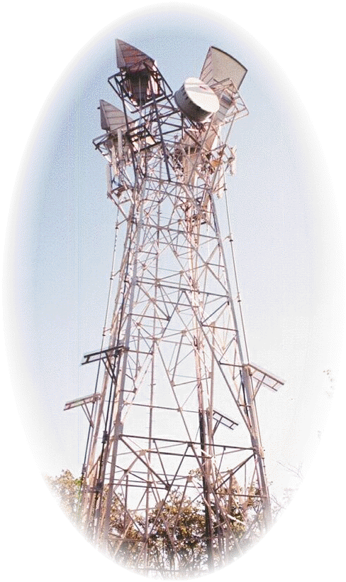





Technology in Action

Slide 2
Technology in Action
Chapter 13
Behind the Scenes:
The Internet: How It Works
Notes:
This chapter takes you behind the scenes of the Internet. We look at how the Internet works and the various standards it follows. Along the way, we go behind the scenes of some Internet communication features, such as e-mail and instant messaging services, and discuss just how safe these features are and what you can do to make your communications even more secure.

Slide 3
Chapter Topics
Managing the Internet
Interaction between Internet components
Internet data transmission and protocols
IP addresses and domain names
FTP and Telnet
HTML and XLM
How e-mail and instant messaging work and how to keep them secure
Notes:
Topics include:
Managing the Internet
Interaction between Internet components
Internet data transmission and protocols
IP addresses and domain names
FTP and Telnet
HTML and XLM
How e-mail and instant messaging work and how to keep them secure

Slide 4
Management of the Internet
Who owns the Internet?
  Individuals
  Universities
  Government agencies
  Private companies
Who manages the Internet?
  Nonprofit organizations
  User groups
Who pays for the Internet?
  U.S. taxpayers
  Businesses
  Universities
  Other countries
Notes:
Although the U.S. government funded the development of the technologies that spawned the Internet, no one really owns it. The individual local networks that constitute the Internet are all owned by different individuals, universities, government agencies, and private companies. Many government entities and privately held companies own pieces of the communications infrastructure that makes the Internet work.
A number of nonprofit organizations and user groups, each with a specialized purpose, are responsible for managing the Internet.
The U.S. government pays for a large portion of the Internet infrastructure as well as funds research and development for new technologies. The primary source of these funds is your tax dollars. Originally, U.S. taxpayers footed the entire bill for the Internet, but as the Internet grew and organizations were formed to manage it, businesses, universities, and other countries began paying for Internet infrastructure and development.

Slide 5
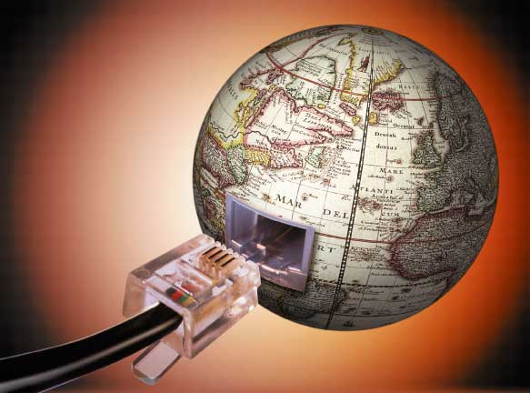
Internet Networking
A network of networks
  Worldwide network of
  computer systems
Protocol
  Set of rules for
  communicating
  All computers connected to the Internet use common protocols so they can understand one another
Notes:
Although the Internet can connect individual computers to each other, the Internet is really a network of networks.
The Internet behaves like a network in that it follows a set of communications protocols and is used for transferring data between computers. A protocol is simply a set of rules for communicating.
All computers connected to the Internet need to use common protocols so they can understand one another.

Slide 6
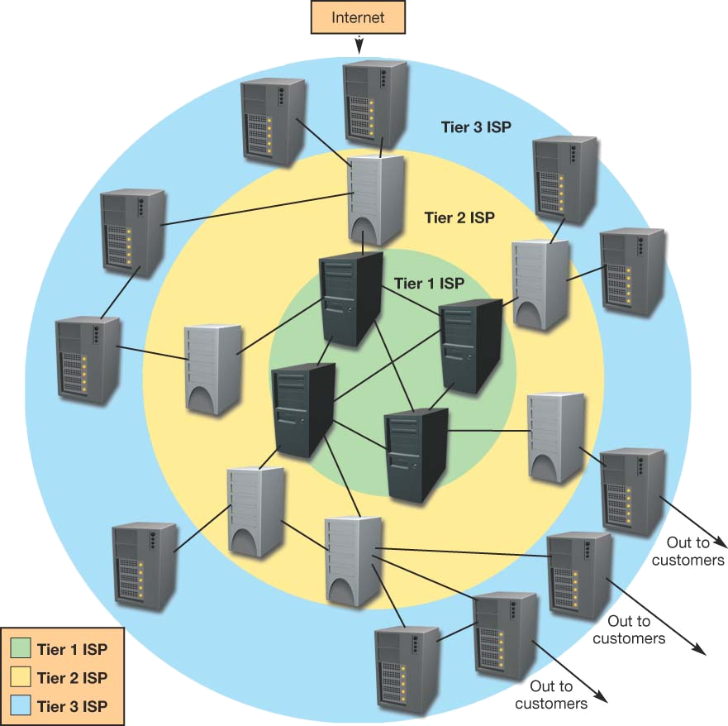
Network Hierarchy
Tier 1
  Internet backbone
  Move large amounts of data
  Provide access to regional ISPs
Tier 2
  Regional ISPs
  Provide access to local ISPs
Tier 3
  Local ISPs
  Provide Internet access to homes and businesses
Notes:
To connect individual computers or networks to the Internet, home users and businesses use Internet service providers (ISPs). ISPs are classified in a hierarchy that consists of three tiers: Tier 1, Tier 2, and Tier 3.
At the heart of the Internet are Tier 1 ISPs, which route a large percentage of the traffic on the Internet and have extremely high-speed connections with other ISPs. The high-speed communications lines that Tier 1 ISPs use are referred to as the Internet backbone. There are dozens of Tier 1 ISPs, each of which is required to be directly connected to all other Tier 1 ISPs.
Tier 2 ISPs usually have a regional or national focus. Tier 2 ISPs must route at least a portion of their traffic through the global Tier 1 ISPs. Information flow between Tier 1 ISPs and the Tier 2 ISPs occurs using high-speed data lines.
The thousands of Tier 3 ISPs provide Internet access to homes or small- to medium-sized businesses. These ISPs normally cover a local area. All Tier 3 ISPs need to be connected to at least one Tier 2 ISP.

Slide 7
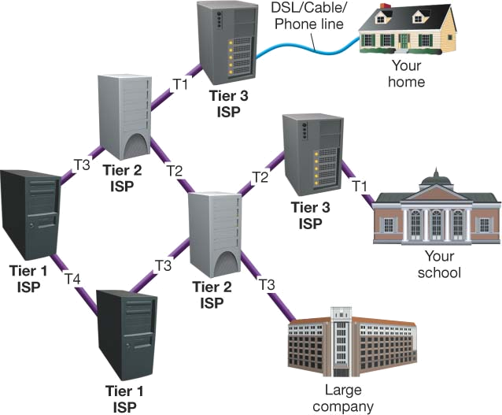
T Lines
High speed fiber-optic lines
T-1 lines
  24 simultaneous voice or data channels
  1.544 Mbps throughput
T-2 lines
  4 T-1 lines
  6.3 Mbps throughput
T-3 lines
  28 T-1 lines
  44.76 Mbps throughput
T-4 lines
  168 T-1 lines
  247.176 Mbps throughput
Notes:
T lines are high-speed fiber-optic communications lines that are designed to provide much higher throughput than conventional voice (telephone) and data (DSL) lines. T lines come in a variety of speeds
A T-1 line can support 24 simultaneous voice or data channels and achieve a maximum throughput of 1.544 Mbps. Businesses or Tier 3 ISPs often use T-1 lines to connect to the Internet because of the large volume of Internet traffic they experience.
T-2 lines are composed of four T-1 lines and deliver a throughput of 6.3 Mbps.
T-3 lines are a bundle of 28 T-1 lines and deliver a throughput of 44.736 Mbps.
T-4 lines contain 168 T-1 lines and provide an astounding 274.176 Mbps of throughput.

Slide 8
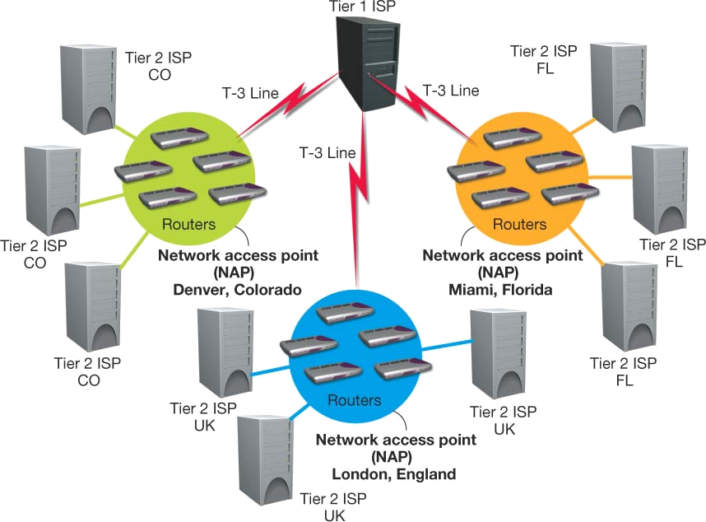
Network Access Points (NAPs)
Points of connection between ISPs
Routers move data between networks
Notes:
The points of connection between ISPs are known as network access points (NAPs).
Network access points contain groups of routers specifically designed to move large amounts of data quickly between networks.

Slide 9
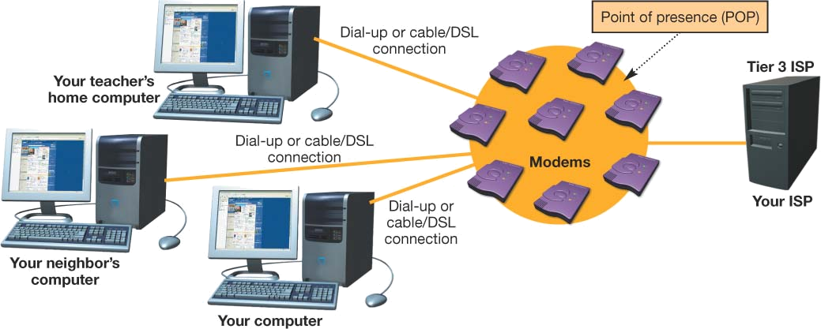
Points of Presence (POP)
Bank of modems where individual users connect to an ISP
Notes:
Whether dialing up through a conventional modem or connecting through high-speed access, individual Internet users enter an ISP through a point of presence (POP), which is basically a bank of modems through which many users can connect to an ISP simultaneously.
ISPs maintain multiple POPs throughout the geographic area they serve.

Slide 10
The Network Model of the Internet
Internet communications follows the client/server network model
Clients request services
Servers respond to requests
Types of servers include
  Web servers
    Host Web pages
  Commerce servers
    Enable the purchase of goods and services over the Internet
  File servers
    Provide remote storage space for files that users
    can download
Notes:
The majority of Internet communications follows the client/server model of network communication.
Client computers request services and servers provide those services to the clients.
There are various types of servers deployed on the networks that make up the Internet from which clients can request services:
-Web servers run specialized operating systems that enable them to host Web pages and provide requested Web pages to clients.
-Commerce servers host software that enables users to purchase goods and services over the Web. These servers generally use special security protocols to protect sensitive information (such as credit card numbers) from being intercepted.
-File servers are deployed to provide remote storage space or to act as a repository for files that users can download.

Slide 11
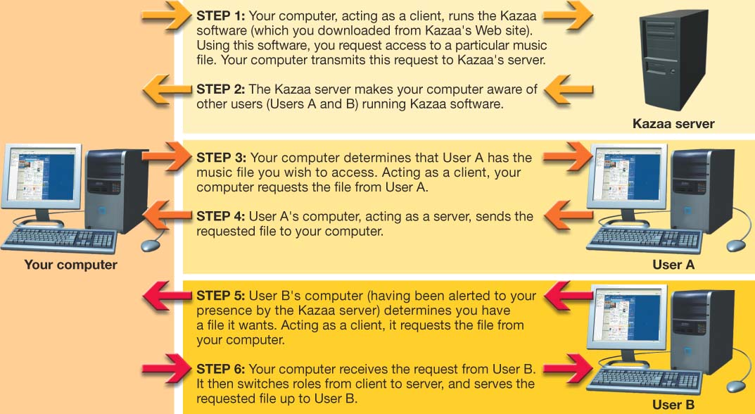
P2P File sharing
Notes:
Certain services on the Internet operate in a peer-to-peer (P2P) mode
Kazaa and other file-sharing services require the user’s computer to act as both a client and a server.
When requesting files from another user, the computer behaves like a client. It switches to server mode when it in turn provides a file stored on its hard drive to another computer.

Slide 12
Data Transmission and Protocols
Computer protocols are rules for electronic information exchange
Open system protocols
  Any computer can communicate with other computers using the same protocols
Notes:
The Internet follows standard protocols to send information between computers.
To accomplish the early goals of the Internet, protocols needed to be written and agreed upon by users. The protocols needed to be open systems, meaning their designs would be made public for access by any interested party.

Slide 13
Circuit Switching
Dedicated connection between two points
Remains active until the transmission is terminated
Used in telephone communications
Notes:
Agreeing on common standards was relatively easy. However, the tough part was developing a new method of communication because the current technology, circuit switching, was not efficient for computer communication.
In circuit switching, a dedicated connection is formed between two points and the connection remains active for the duration of the transmission. This method of communication is extremely important when communications must be received in the order in which they are sent (such as in telephone conversations).
When applied to computers, however, circuit switching is inefficient. Computer processing and communication take place in bursts. As a computer processor performs the operations necessary to complete a task, it transmits data in a group (or burst). The processor then begins working on its next task and ceases to communicate with output devices or other networks until it is ready to transmit data in the next burst.
Circuit switching is inefficient for computers because the circuit either would have to remain open (and therefore unavailable to any other system) with long periods of inactivity, or it would have to be reestablished for each burst.

Slide 14
Packet Switching
Data is broken into small units called packets
Packets are sent over various routes to their destination
Packets are reassembled by the receiving computer
Packets contain
  Destination/source addresses
  Reassembling instructions
  Data
Notes:
Packet switching is the communications methodology that makes computer communication efficient.
Packet switching doesn’t require that a dedicated communications circuit be maintained. With packet switching, data is broken into smaller chunks (called packets) that are sent over various routes at the same time.
When the packets reach their destination, they are reassembled by the receiving computer.
Packet contents vary depending on the protocol being followed. At a minimum, all packets must contain (1) an address to where the packet is being sent, (2) reassembling instructions if the original data was split between packets, and (3) the data that is being transmitted.

Slide 15
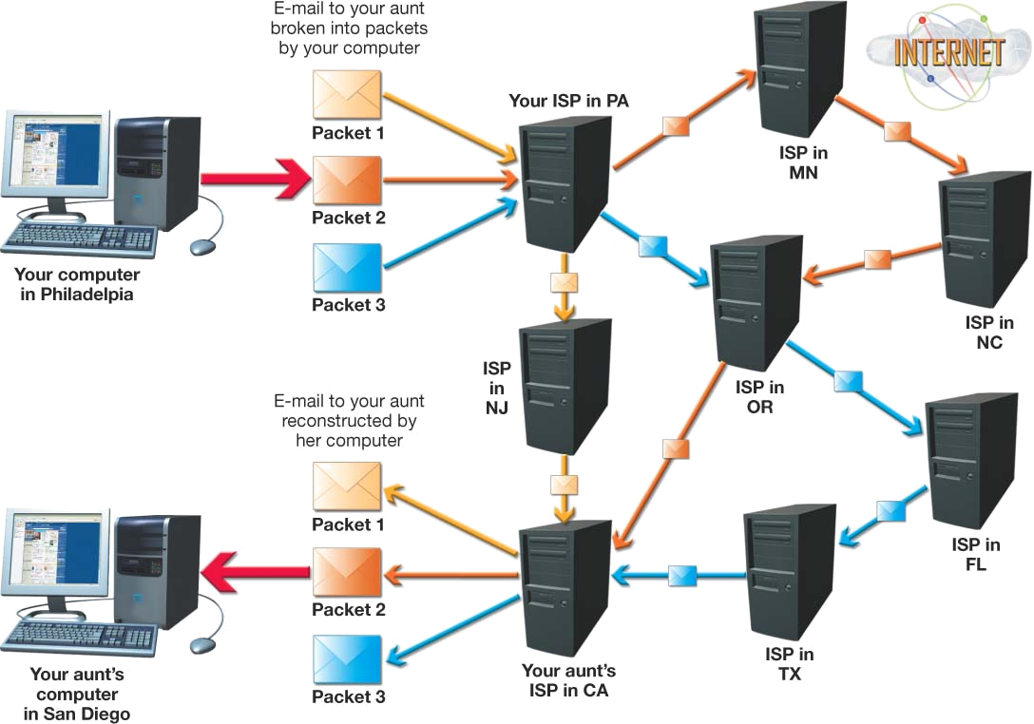
Packet Switching
Notes:
The routers that connect ISPs with each other monitor traffic and decide on the most efficient route for packets to take to their destination.

Slide 16
TCP/IP
Transmission Control Protocol (TCP)
  Prepares data for transmission
  Provides error checking
  Enables resending lost data
Internet Protocol (IP)
  Responsible for sending data from one computer to another
Notes:
Although many protocols are available on the Internet, the main suite of protocols used is TCP/IP.
The suite is named after the original two protocols that were developed for the Internet: the Transmission Control Protocol (TCP) and the Internet Protocol (IP).
TCP prepares data for transmission and provides for error checking and resending lost data.
IP is responsible for sending the information from one computer to another.

Slide 17
IP Addresses
Unique number that identifies devices connected to the Internet
Typical IP address
  197.24.72.157
Static address
  Address never changes
Dynamic address
  Temporary address
Notes:
Each computer, server, or device connected to the Internet is required to have a unique number identifying it, called an IP address.
A typical IP address is expressed as a dotted decimal number.
IP addresses are either assigned statically or dynamically.
Static addressing means that the IP address for a computer never changes and is most likely assigned manually by a network administrator.
In dynamic addressing, your computer is assigned a temporary address from an available pool of IP addresses.

Slide 18
Domain Names
Name that takes the place of an IP address
Sample domain name
  www.mywebsite.com
Top-level domains (TLD)
  Portion of the domain name that follows the dot
  Sample top-level domain names
    .com, .org, .edu, and .net
Second-level domains
  Unique name within a top-level domain
  Sample second-level domain names
    Yahoo.com, Google.com, and Unesco.org
Notes:
A domain name is simply a name that takes the place of an IP address, making it easier for people to remember. For example, mywebsite.com is a domain name.
Domains are organized by level. The portion of the domain name farthest to the right (after the dot) is the top-level domain (TLD). The TLDs are standardized pools established by ICANN (such as .com and .org).
Within the top-level domains are many second-level domains. In the .com domain, there are popular sites such as Amazon.com, Google.com, and Microsoft.com. Each of the second-level domains needs to be unique within that particular domain, but not necessarily unique to all top-level domains. For example, Mycoolsite.com and Mycoolsite.org could be registered as separate domain names.

Slide 19
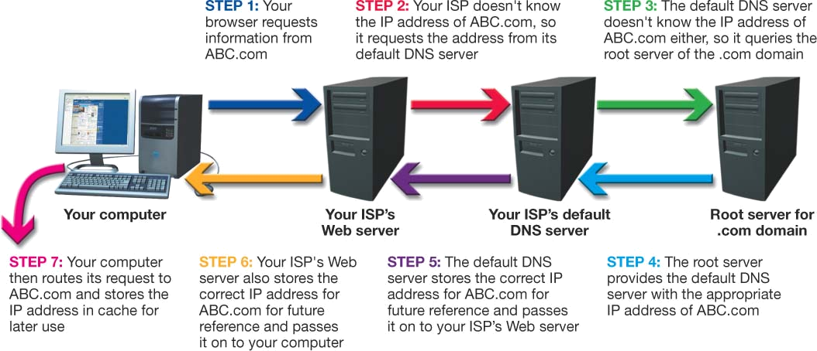
DNS
Domain Name Server
Internet servers that translate domain names to IP addresses
ISPs go first to a default DNS to resolve a name
Name queries work up the hierarchy to the root DNS servers if required
Notes:
Say you want to get to Yahoo.com. To do so, you type the URL www.yahoo.com into your browser. When you enter the URL, your computer must convert it to an IP address. To do this, your computer consults a database maintained on a DNS server, which functions like a phone book for the Internet.
Your ISP’s Web server has a default DNS server that it goes to when it needs to translate a URL to an IP address.
If all else fails, it contacts one of the many root DNS servers maintained throughout the Internet. The root DNS servers know the location of all the DNS servers that contain the master listings for an entire TLD. Your default DNS receives the information from the master DNS (say, for the .com domain), then stores that information in its cache for future use and communicates the appropriate IP address to your computer.

Slide 20
Other Protocols
File Transfer Protocol (FTP)
  File-sharing protocol
  Files are downloaded and uploaded using
  the Internet
Telnet
  Protocol for connecting to a remote computer and a TCP/IP service
  Enables a client computer to control a server computer
Notes:
Other commonly used protocols on the Internet are the File Transfer Protocol (FTP) and Telnet.
The File Transfer Protocol (FTP) enables users to share files that reside on local computers with remote computers. If you’re attempting to download files using FTP to your local computer, the FTP client program first establishes a TCP session with the remote computer.
Telnet is both a protocol for connecting to a remote computer and a TCP/IP service that runs on a remote computer to make it accessible to other computers. Telnet enables you to take control of a remote computer (the server) with your computer (the client) and manipulate files and data on the server as if you were sitting in front of that server.

Slide 21
HTTP and SSL
Hypertext Transfer Protocol
  Protocol for transferring hypertext documents
  Hypertext documents are linked to other documents (through hyperlinks)
Secure Socket Layer
  Security protocols that protect sensitive information
  Encrypts data
Notes:
The Hypertext Transfer Protocol (HTTP) was created especially for the transfer of hypertext documents across the Internet.
Hypertext documents are documents in which text is linked to other documents or media (such as video clips, pictures, and so on). Clicking a specific piece of text (called a hyperlink) that has been linked elsewhere takes you to the linked file.
Commerce servers use security protocols to protect sensitive information from being intercepted by hackers. One common protocol is the Secure Sockets Layer (SSL), which provides for the encryption of data transmitted using TCP/IP protocols such as HTTP. All major Web browsers support SSL.

Slide 22
HTML/XHTML
Hypertext Markup Language (HTML)
  Format for creating Web pages
Extensible Hypertext Markup Language (XHTML)
  Current version of HTML
  Has much more stringent rules than HTML regarding tagging
HTML/XHTML are not programming languages but sets of rules for marking up blocks of text so that a browser knows how to display them
Notes:
A Web page is merely a text document that is formatted using the Hypertext Markup Language (HTML).
The current version of HTML is called the Extensible Hypertext Markup Language (XHTML). XHTML has much more stringent rules than HTML regarding tagging (for instance, all elements require an end tag).
XHTML is the development environment of choice for Web developers today, although many people still refer to Web site formatting as HTML tagging.
HTML/XHTML are not programming languages; rather, they are sets of rules for marking up blocks of text so that a browser knows how to display them.

Slide 23
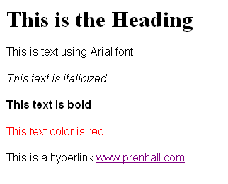
HTML/XHTML Example
HTML/XHTML
Web Page Display
<h1>This is the Heading</h1>
<p><font face="Arial">This is text using Arial font.</font></p>
<p><font face="Arial"><i>This text is italicized</i>.</font></p>
<p><font face="Arial"><b>This text is bold</b>.</font></p>
<p><font face="Arial"><font color="#FF0000">This text color is red</font>.</font></p>
<p><font face="Arial">This is a hyperlink <a href="http://vig.prenhall.com/">
www.prenhall.com</a></font></p>
Notes:
Here you see an example of HTML/XHTML tags and what they produce

Slide 24
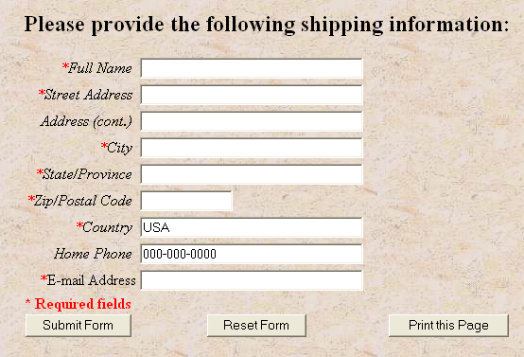
Common Gateway Interface (CGI)
Browsers request that a program file executes (runs)
CGI files often called CGI scripts
Adds Web page interaction
  Adding names to guest books/mailing lists
  Completing forms
Notes:
The Common Gateway Interface (CGI) provides a methodology by which your browser can request that a program file be executed (or run) instead of just being delivered to the browser. This enables functionality beyond the simple displaying of information.
CGI files can be created in almost any programming language, and the programs created are often referred to as CGI scripts.
Almost any task can be accomplished by writing a CGI script, such as creating a guest book or form on a Web page.

Slide 25
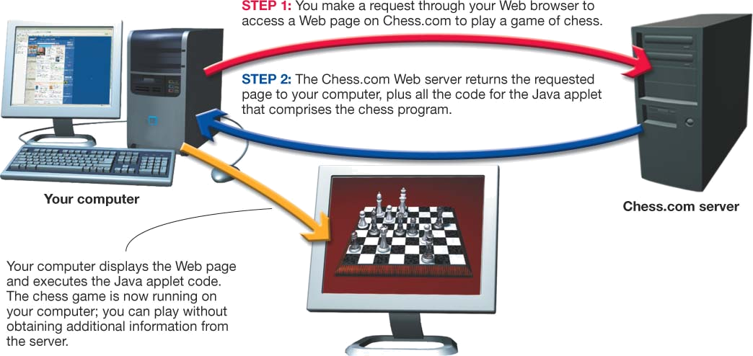
Client-Side Applications
A program that runs on a client computer with no interaction with the server
Types of client-side applications include
  HTML/XHTML document embedded with JavaScript code
  Applet: Small program that resides on the server
Notes:
Therefore, client-side applications were created. A client-side application is a computer program that runs on the client and requires no interaction with a Web server. Client-side applications are fast and efficient because they run at your desktop and don’t depend on sending signals back and forth to the Web server.
Two main types of client-side methods exist.
-The first involves embedding programming language code directly within the HTML/XHTML code of a Web page using an HTML/XHTML embedded scripting language.
-The second type of client-side application is an applet, a small program that resides on a server. When requested, a compiled version of the program is downloaded to the client computer and run there.

Slide 26
Extensible Markup Language (XML)
Designed for information exchange
Tools used to create your own markup language
Used in e-commerce transactions
Notes:
Because HTML/XHTML is not designed for exchanging information, XML is used.
Extensible Markup Language (XML) is a set of tools you can use to create your own markup language. In a sense, it is a more flexible version of HTML/XHTML. Instead of being locked into standard tags and formats for data, users can build their own markup languages to accommodate particular data formats and needs.

Slide 27
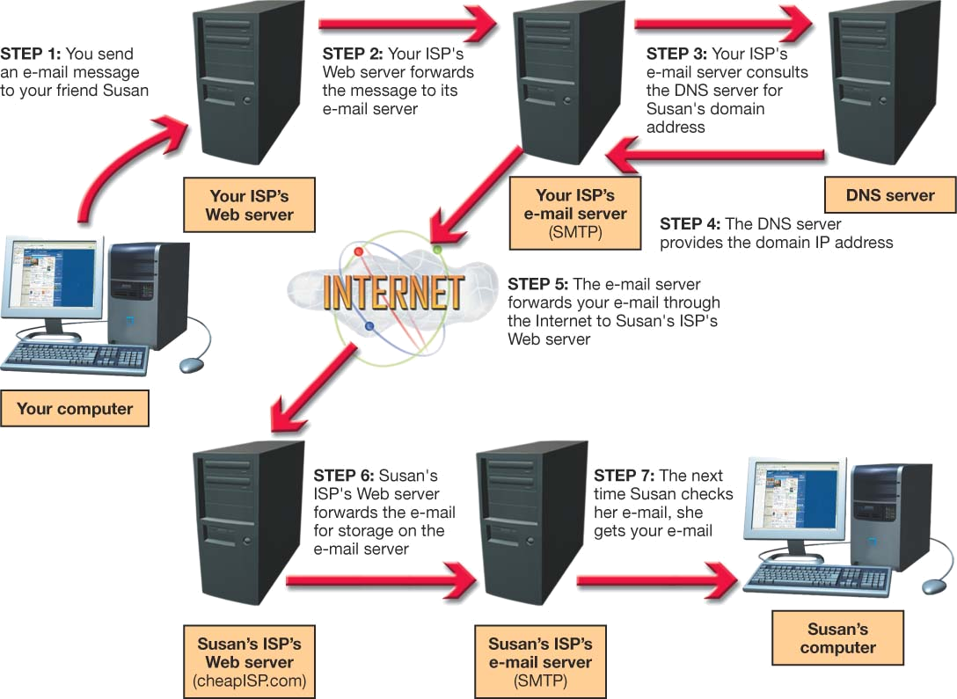
Communications Over the Internet
E-mail
  Created in 1971 by Ray Tomlinson
  Simple Mail Transfer Protocol (SMTP)
  Multipurpose Internet Mail Extensions (MIME): Protocol for attaching files to e-mail
Notes:
E-mail uses a protocol first developed by Ray Tomlinson in 1971. Using the @ symbol, e-mail addresses place a user at a Web location. The protocol works in a client/server format where e-mail is sent to a server and is forwarded to another server where it is retrieved by the addressee.
Just like other kinds of data that flow along the Internet, e-mail has its own protocol. The Simple Mail Transfer Protocol (SMTP) is responsible for sending e-mail along the Internet to its destination.
The Multipurpose Internet Mail Extensions (MIME) specification was introduced in 1991 to simplify adding attachments to e-mail messages. All e-mail client software now uses this protocol for attaching files.

Slide 28
Communications Over the Internet
E-mail security
  Encryption
    Private-key encryption
    Public-key encryption
  Secure data transmission software
    SafeMessage
Notes:
E-mail is very susceptible to being read by unintended parties because it’s sent in plain text. Also, copies of your e-mail message may exist (temporarily or permanently) on numerous servers as it makes its way through the Internet. Two options exist for protecting your sensitive e-mail messages: encryption and secure data transmission software.
Encryption refers to the process of coding your e-mail so that only the person with the key to the code (the intended recipient) can decode (or decipher) and read the message. There are two basic types of encryption: private-key and public-key.
-In private-key encryption, only the two parties involved in sending the message have the code. The main problem with private-key encryption is key security. If someone steals a copy of the code, the code is broken.
-In public-key encryption, two keys, known as a key pair, are created. You use one key for coding and the other for decoding. The key for coding is generally distributed as a public key. You can place this key on your Web site, for instance. Anyone wishing to send you a message codes it using your public key. When you receive the message, you use your private key to decode it. You are the only one who ever possesses the private key and therefore it is very secure.
Using encryption doesn’t always solve the other problems associated with e-mail. Messages leave a trail as they travel over the Internet, and copies of messages can exist on servers for long periods of time. In addition, immediate reading of sensitive documents is often essential, but encryption software doesn’t provide a means for confirming your messages have been delivered. To combat these issues, companies such as Securus Systems Ltd. have developed secure data transmission software (called SafeMessage) that works outside of the conventional SMTP mail servers.

Slide 29
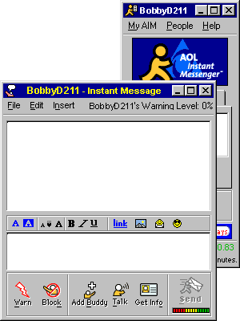
Instant Messaging (IM)
Client/server application program for real-time, text-based conversations
Popular instant messaging programs
  AOL Instant Messenger
  ICQ
  Yahoo! Messenger
  Windows Messenger
Notes:
Instant messaging (IM) is another client/server application. AOL Instant Messenger (AIM), ICQ, Yahoo! Messenger, and MSN Messenger are the top four instant messaging applications in use today.
The client software running on your computer makes a connection with the chat server using your Internet connection. Once contact is established, you can log in to the server with your name and password. The client software provides the server with connection information for your computer. The server then consults the list of contacts that you have previously established in your account and checks to see if any of your contacts are online. If any are, the server sends a message back to your client providing the necessary connection information (the IP addresses) for your friends. You can now click your friends’ names to establish a chat session with them.

Slide 30
Chapter 13 Summary Questions
What data transmissions and protocols does the Internet use?
Notes:
What data transmissions and protocols does the Internet use?

Slide 31
Chapter 13 Summary Questions
How do the Internet’s networking components interact?
Notes:
How do the Internet’s networking components interact?

Slide 32
Chapter 13 Summary Questions
What data transmissions and protocols does the Internet use?
Notes:
What data transmissions and protocols does the Internet use?

Slide 33
Chapter 13 Summary Questions
Why are IP addresses and domain names important for Internet communications?
Notes:
Why are IP addresses and domain names important for Internet communications?

Slide 34
Chapter 13 Summary Questions
What are FTP and Telnet and how do I use them?
Notes:
What are FTP and Telnet and how do I use them?

Slide 35
Chapter 13 Summary Questions
What are HTML and XML used for?
Notes:
What are HTML and XML used for?

Slide 36
Chapter 13 Summary Questions
How do e-mail and instant messaging work and how are messages kept secure?
Notes:
How do e-mail and instant messaging work and how are messages kept secure?

